Slide 1
FortiGate Infrastructure
SSL VPN
FortiOS 7.2
Notes:
In this lesson, you will learn how to configure and use SSL VPNs. SSL VPNs are an easy way to give remote users access to your private network.

Slide 2
SSL VPN Deployment Modes
Configuring SSL VPNs
Monitoring and Troubleshooting
Notes:
In this lesson, you will learn about the topics shown on this slide.

Slide 3
SSL VPN Deployment Modes
Describe the differences between SSL VPN modes
Notes:
After completing this section, you should be able to achieve the objective shown on this slide. By demonstrating competence in understanding the different ways FortiGate allows SSL VPN connections, you will be able to better design the configuration of your SSL VPN.

Slide 4
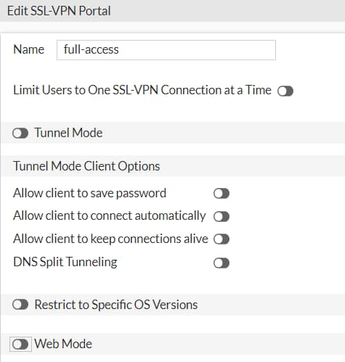
SSL VPN Deployment Modes
Tunnel mode
  Accessed through a FortiClient
  Requires a virtual adapter on the client host
Web mode
  Requires only a web browser
  Supports a limited number of protocols:
    FTP, HTTP/HTTPS, RDP, SMB/CIFS, SSH, Telnet, VNC, and Ping
VPN > SSL VPN Portals
config vpn ssl web portal
edit <portal-name>
  set tunnel-mode [enable|disable]
  set web-mode [enable|disable]
  end
Notes:
There are two modes you can use to access an SSL VPN. Both can build an SSL VPN connection, but they don’t support the same features.
Which should you choose?
It depends on which applications you need to send through the VPN, the technical knowledge of your users, and whether or not you have administrative permissions on their computers.
Tunnel mode supports the most protocols, but requires the installation of a VPN client, or more specifically, a virtual network adapter. To tunnel traffic using the virtual adapter, you must use the FortiClient remote access feature or FortiClient VPN-only client.
Web mode requires only a web browser, but supports a limited number of protocols.

Slide 5
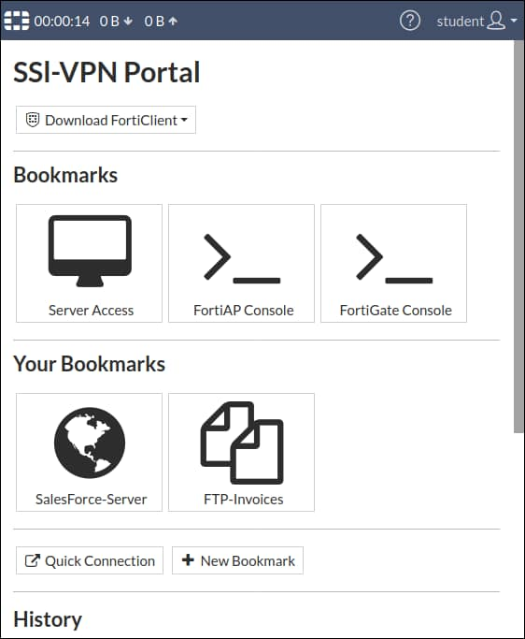
Web Mode
Connect to the FortiGate SSL VPN portal from any browser
  The web portal displays the status of SSL VPN
  The SSL VPN stays up only while the SSL VPN portal page is open
Access internal network resources easily using:
  Bookmarks
  Quick connection
Disadvantages:
  Interaction with the internal network exclusively by browser
    Through the SSL VPN portal
    External network applications cannot send data across the VPN
  Limited number of protocols supported
Notes:
Web mode is the simplest SSL VPN mode.
Like you would with any other HTTPS website, you simply log in to the SSL VPN portal web page on FortiGate. It acts like a server-side reverse proxy, or a simple secure HTTP/HTTPS gateway, that connects you with the applications on the private network.
The Bookmarks section on the SSL VPN Portal page contains links to all or some of the resources available for the user to access. The Quick Connection widget allows users to type the URL or IP address of the server they want to reach. A web SSL VPN user makes use of these two widgets to access the internal network. The main advantage of web mode is that it does not usually require you to install extra software.
Web mode has two main disadvantages:
All interaction with the internal network must be done using the browser exclusively (through the web portal). External network applications running on the user’s PC cannot send data across the VPN.
This a secure HTTP/HTTPS gateway mechanism that doesn’t work for accessing everything, but just few popular protocols, such as HTTP, FTP, and Windows shares.

Slide 6
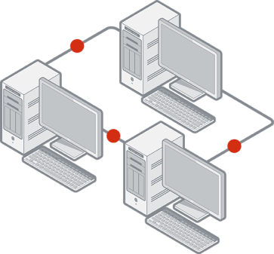


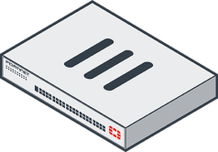
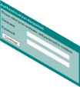




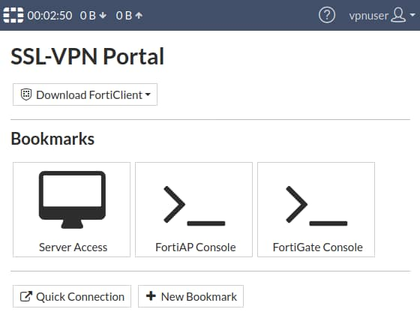
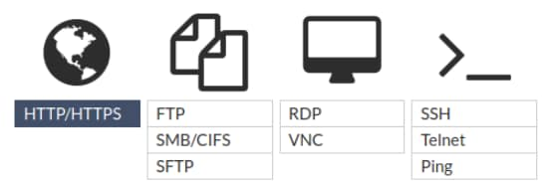
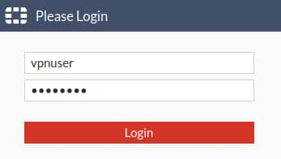
Web Mode (Contd)
Remote users connect to the SSL VPN portal—HTTPS web page on FortiGate
Users authenticate
Users access resources through the Quick Connection launcher or Bookmarks
User’s source IP is replaced by FortiGate’s internal IP address
By Quick Connection launcher or Bookmarks
HTTPS to SSL VPN Portal
Notes:
How does web mode work?
Remote users establish a secure connection between the SSL security in the web browser and the FortiGate SSL VPN portal, using HTTPS.
Once connected, users provide credentials in order to pass an authentication check.
Then, FortiGate displays the SSL VPN portal that contains services and network resources for users to access.
Different users can have different portals with different resources and access permissions. Also notice the source IP seen by the remote resources is FortiGate’s internal IP address and not the user’s IP address.

Slide 7

Tunnel Mode
Connect to FortiGate through FortiClient
  Tunnel is up only while the SSL VPN client is connected
  FortiClient adds a virtual network adapter called fortissl
FortiGate establishes the tunnel
  Assigns a virtual IP address to the client from a pool of reserved addresses
  All traffic is encapsulated with SSL/ TLS
Advantage:
  Any IP network application on the client can send traffic through the tunnel
Disadvantage:
  Requires the installation of a VPN client
  http://www.forticlient.com/
Notes:
Tunnel mode is the second option FortiGate provides to access resources within an SSL VPN.
Tunnel mode requires FortiClient to connect to FortiGate. FortiClient adds a virtual network adapter identified as fortissl to the user’s PC. This virtual adapter dynamically receives an IP address from FortiGate each time FortiGate establishes a new VPN connection. Inside the tunnel, all traffic is SSL/TLS encapsulated.
The main advantage of tunnel mode over web mode is that after the VPN is established, any IP network application running on the client can send traffic through the tunnel. The main disadvantage is that tunnel mode requires the installation of a VPN software client, which requires administrative privileges.

Slide 8

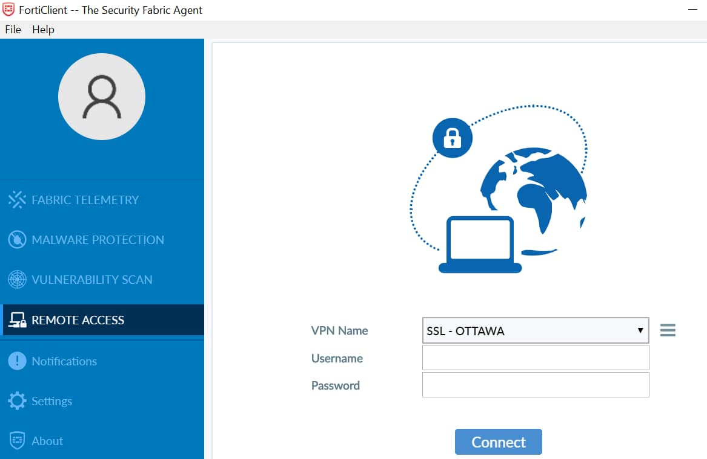
Tunnel Mode (Contd)
Remote users connect to the SSL VPN gateway through the SSL VPN client
Users authenticate
The virtual adapter creates the tunnel
Users access resources through an encrypted tunnel (SSL/TLS)
User traffic source IP address is assigned by FortiGate, like IPsec
SSL VPN Tunnel
Notes:
How does tunnel mode work?
Users connect to FortiGate through FortiClient.
Users provide credentials to successfully authenticate.
FortiGate establishes the tunnel and assigns an IP address to the client’s virtual network adapter (fortissl). This is the client’s source IP address for the duration of the connection.
Then, users can access services and network resources through the encrypted tunnel.
FortiClient encrypts all traffic from the remote computer and sends it over the SSL VPN tunnel. FortiGate receives the encrypted traffic, de-encapsulates the IP packets, and forwards them to the private network as if the traffic originated from inside the network.

Slide 9
Tunnel Mode—FortiGate as Client
Connect to server FortiGate device as SSL VPN client
  Use SSL VPN Tunnel interface type
  Devices connect to client FortiGate device can access the resources behind server FortiGate
Tunnel establishes between two FortiGate devices
  Hub-and-spoke topology
  Client FortiGate dynamically adds route to remote subnets
  Assigns a virtual IP address to the client FortiGate device from a pool of reserved addresses
Advantage:
  Any IP network application on the user machines connect to client FortiGate device can send traffic through the tunnel
  Useful to avoid issues caused by intermediate devices, such as:
    ESP packets being blocked.
    UDP ports 500 or 4500 being blocked.
    Fragments being dropped, causing IKE negotiation that uses large certificates to fail if the peer does not support IKE fragmentation.
Disadvantage:
  Requires proper CA certificate on SSL VPN Server FortiGate
  SSL VPN Client FortiGate user uses PSK and PKI client certificate to authenticate
Notes:
The FortiGate can be configured as an SSL VPN client, using an SSL-VPN Tunnel interface type. When an SSL VPN client connection is established, the client dynamically adds a route to the subnets that are returned by the SSL VPN server. Policies can be defined to allow users that are behind the client to be tunneled through SSL VPN to destinations on the SSL VPN server.
This setup provides IP-level connectivity in tunnel mode and allows hub-and-spoke topologies to be configured with FortiGates as both the SSL VPN hub and spokes. This can be useful to avoid issues caused by intermediate devices, such as:
ESP packets being blocked.
UDP ports 500 or 4500 being blocked.
Fragments being dropped, causing IKE negotiation that uses large certificates to fail if the peer does not support IKE fragmentation.
If the client specified destination is all, a default route is effectively dynamically created on the SSL VPN client, and the new default route is added to the existing default route in the form of ECMP. You can modify route’s distance or priority according to your requirements. To avoid a default route being learned on the SSL VPN client, on the SSL VPN server define a specific destination. Split tunneling is used so that only the destination addresses defined in the server's firewall policies are routed to the server, and all other traffic is connected directly to the internet.
This configuration requires proper CA certificate installation as the SSL VPN client FortiGate/user uses PSK and a PKI client certificate to authenticate. The FortiGate devices must have the proper CA certificate installed to verify the certificate chain to the root CA that signed the certificate.

Slide 10


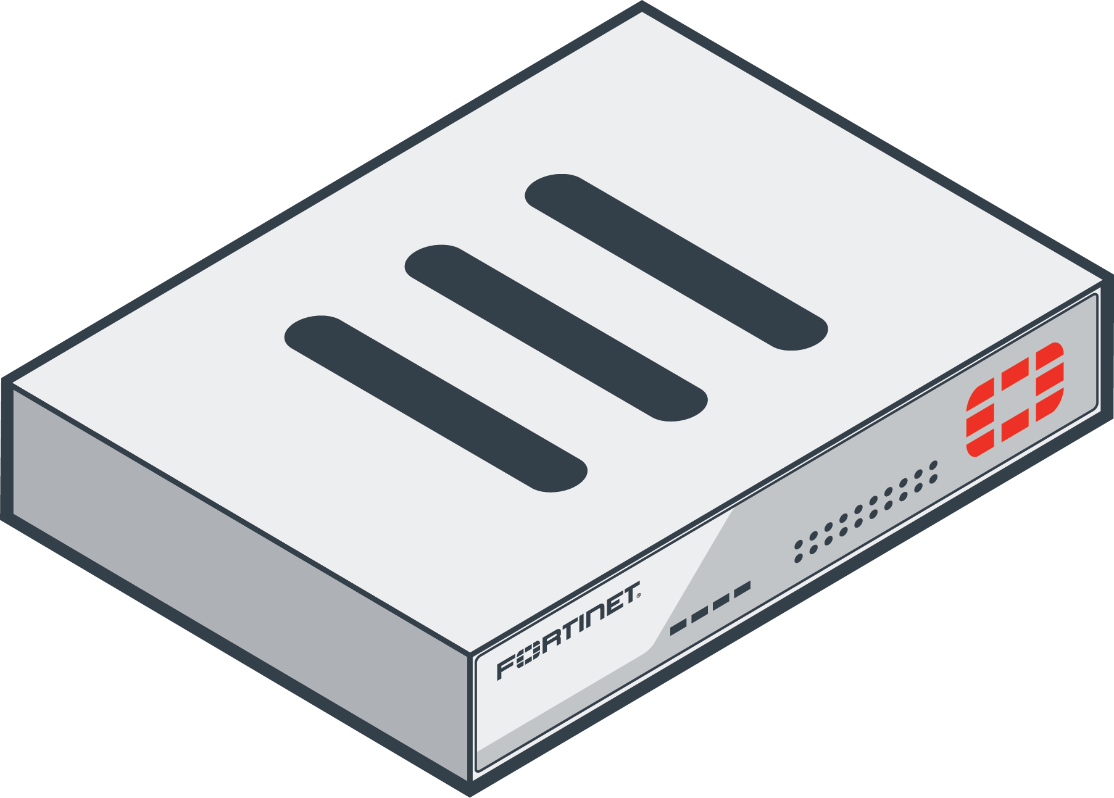

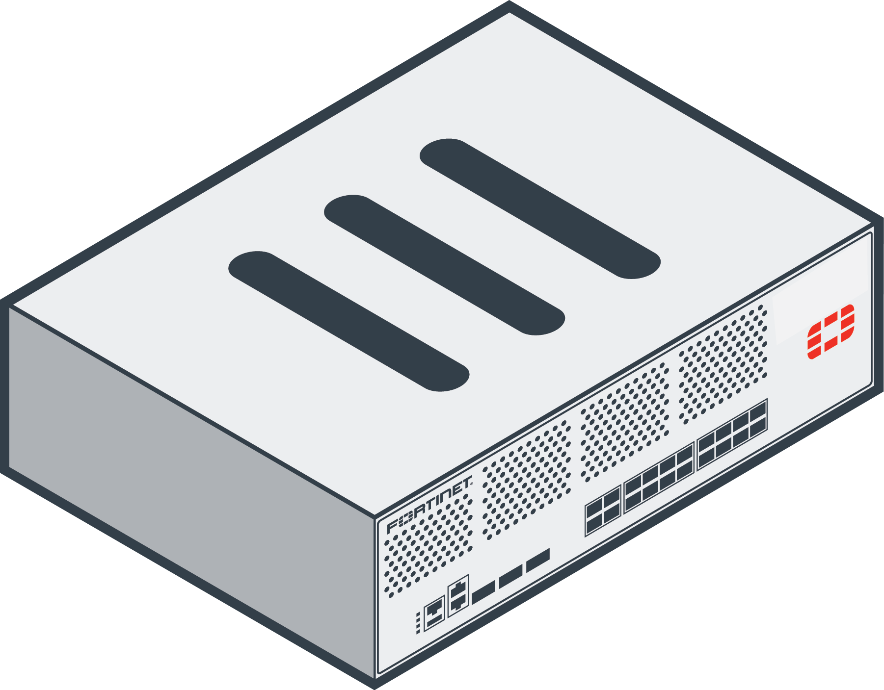

Tunnel Mode—FortiGate as Client (Contd)
SSL VPN client FortiGate initiates connection to SSL VPN server FortiGate
SSL VPN client FortiGate uses PSK(local user account) and PKI client to authenticate
The virtual SSL VPN tunnel interface creates the tunnel
  IP address assigned from SSL VPN server FortiGate
  Route is added to client to access subnets on remote FortiGate
User’s devices access resources through an encrypted tunnel (SSL/TLS)
Branch Office/Home FortiGate
HQ/Company FortiGate
Port4
SSL VPN Tunnel
Port1
Port2
Port3
SSL-VPN Client
SSL-VPN Server
Virtual Interface: sslclient_port
Remote Resources
User’s Devices
Notes:
How does tunnel mode work when FortiGate is configured as client?
Client FortiGate connects to server FortiGate using SSL/TLS
Client FortiGate provides credentials to successfully authenticate. It includes both PSK (local or remote user account) and PKI (certificate) accounts.
Server FortiGate establishes the tunnel and assigns an IP address to the client’s virtual network adapter. This is the client’s source IP address for the duration of the connection.
Then, users can access services and network resources through the encrypted tunnel behind client FortiGate.
SSL VPN client FortiGate device encrypts all traffic from the remote computer and sends it over the SSL VPN tunnel. SSL VPN server FortiGate receives the encrypted traffic, de-encapsulates the IP packets, and forwards them to the private network as if the traffic originated from inside the network.

Slide 11
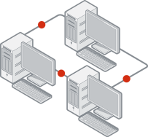


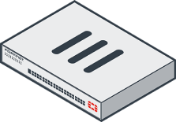

Tunnel Mode—Split Tunneling
Disabled:
  All traffic routes through an SSL VPN tunnel to a remote FortiGate, then to the destination. This includes internet traffic
  An egress firewall policy is required
  Traffic inspection and security features can be applied
Enabled:
  Only traffic destined for the private network is routed through the remote FortiGate
  Internet traffic uses the local gateway; unencrypted route
  Conserves bandwidth and alleviates bottlenecks
  There is no traffic inspection by FortiGate
SSL VPN Tunnel
Split tunneling enabled
Split tunneling disabled
Notes:
Tunnel mode also supports split tunneling.
When split tunneling is disabled, all IP traffic generated by the client’s computer—including internet traffic—is routed across the SSL VPN tunnel to FortiGate. This sets up FortiGate as the default gateway for the host. You can use this method in order to apply security features to the traffic on those remote clients, or to monitor or restrict internet access. This adds more latency and increases bandwidth usage.
In a FortiGate (client) to FortiGate (server) setup, a default route is effectively dynamically created on the SSL VPN client FortiGate, and the new default route is added to the existing default route in the form of ECMP. The following options are available to configure routing:
To make all traffic default to the SSL VPN server and still have a route to the server's listening interface, on the SSL VPN client, set a lower distance for the default route that is learned from the server.
To include both default routes in the routing table, with the route learned from the SSL VPN server taking priority, on the SSL VPN client, set a lower distance for the route learned from the server. If the distance is already zero, then increase the priority on the default route.
When split tunneling is enabled, only traffic that is destined for the private network behind the remote FortiGate is routed through the tunnel. All other traffic is sent through the usual unencrypted route. There is no traffic inspection by FortiGate.
Split tunneling helps to conserve bandwidth and alleviates bottlenecks.

Slide 12

A web-mode SSL VPN user connects to a remote web server. What is the source IP address of the HTTP request the web server receives?
  The remote user IP address
  The FortiGate device internal IP address
Which statement about tunnel-mode SSL VPN is correct?
  It supports split tunneling.
  It requires bookmarks.
A web-mode SSL VPN user uses ______ to access internal network resources.
  bookmarks
  FortiClient

Slide 13
SSL VPN Deployment Modes
Configuring SSL VPNs
Monitoring and Troubleshooting
Notes:
Good job! You now understand the SSL VPN operation modes supported by FortiGate.
Now, you will learn about how to configure SSL VPNs.

Slide 14
Configuring SSL VPNs
Define authentication for SSL VPN users
Configure SSL VPN portals
Configure SSL VPN settings
Define firewall policies for SSL VPNs
Configure client integrity check
Notes:
After completing this section, you should be able to achieve the objectives shown on this slide.
By demonstrating competence in configuring the SSL VPN settings on FortiGate, you will be able to better design the architecture of your SSL VPN tunnels.

Slide 15
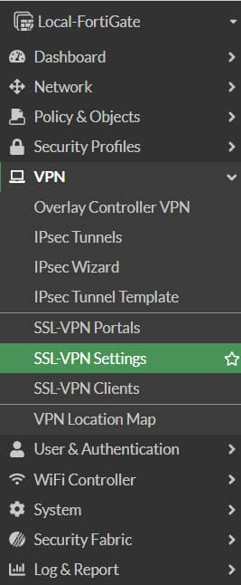
Configuring SSL VPN—User as Client
Set up user accounts and groups for remote SSL VPN users
Configure SSL VPN portals
Configure SSL VPN settings
Create a firewall policy to and from the SSL VPN interface
  Accepts and decrypts packets
  Allows traffic from SSL VPN clients to the internal network and the reverse
Optionally:
  Create a firewall policy to allow SSL VPN traffic to the internet:
    Useful to allow all clients’ traffic through FortiGate to Internet when split tunneling
    is disabled
    FortiGate can be used to apply security profiles
4
5
2
3
1
Notes:
To configure SSL VPN, you must take these steps:
Configure user accounts and groups.
Configure the SSL VPN portal.
Configure SSL VPN settings.
Create a firewall policy to accept and decrypt packets. This policy is also used to provide access to internal networks.
Optionally, configure a firewall policy to allow traffic from the SSL VPN client to the internet and apply security profiles. User traffic will go to the internet through FortiGate, where you can monitor or restrict client access to the internet.
The first step is to create the accounts and user groups for the SSL VPN clients.
All FortiGate authentication methods, with the exception of remote password authentication using the Fortinet Single Sign-On (FSSO) protocol, can be used for SSL VPN authentication. This includes local password authentication and remote password authentication (using the LDAP, RADIUS, and TACACS+ protocols).
Some steps can be configured in a different order than what is shown on this slide.

Slide 16
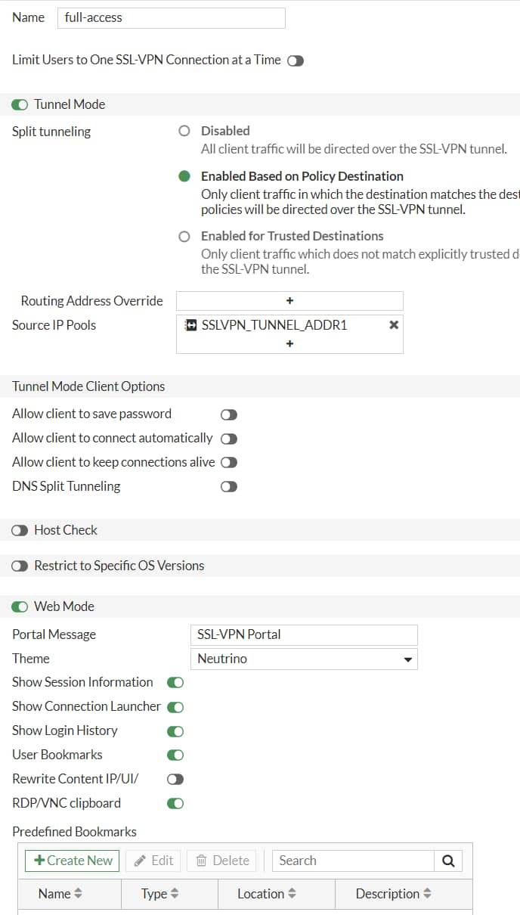
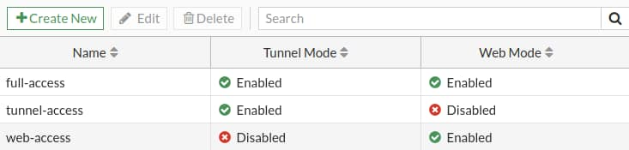
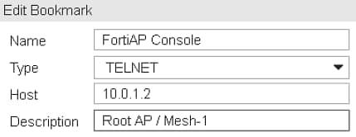
Configure the SSL VPN Portal
SSL VPN portals determine the access profiles
  Configure portals for different user or groups
SSL VPN portals can operate in:
  Tunnel mode
    Activate split tunneling in the Enable Split Tunneling option
    Assign an IP address to the end user virtual network adapter in Source IP Pool: fortissl
  Web mode
    Use direct connection or bookmarks to several applications such as: FTP, HTTP/HTTPS, RDP, SMB/CIFS, SSH, TELNET, VNC
VPN > SSL VPN Portals
Tunnel Mode
Web Mode
Administrator-defined bookmarks
Notes:
The next step is to configure the SSL VPN portal(s). An SSL VPN portal contains tools and resource links for the users to access.
In tunnel mode, when you enable split tunneling, you need to select either Enabled Based on Policy Destination or Enabled for Trusted Destination setting, which usually specifies networks behind the FortiGate for the SSL VPN users to access. Enabled Based on Policy Destination allows client traffic in which destination is matched with the destination configured on the SSL VPN firewall policy where as Enabled for Trusted Destination allows client traffic that does not match the explicitly trusted destination.
Also, for tunnel mode you need to select an IP pool for users to acquire an IP address when connecting. There is a default pool available within the address objects if you do not create your own.
If you enable web mode, you can customize the SSL VPN portal and preconfigure bookmarks to appear for all users who log in to the SSL VPN portal. Also, you can individually configure and link each portal to a specific user or user group, so they have access to only required resources.

Slide 17
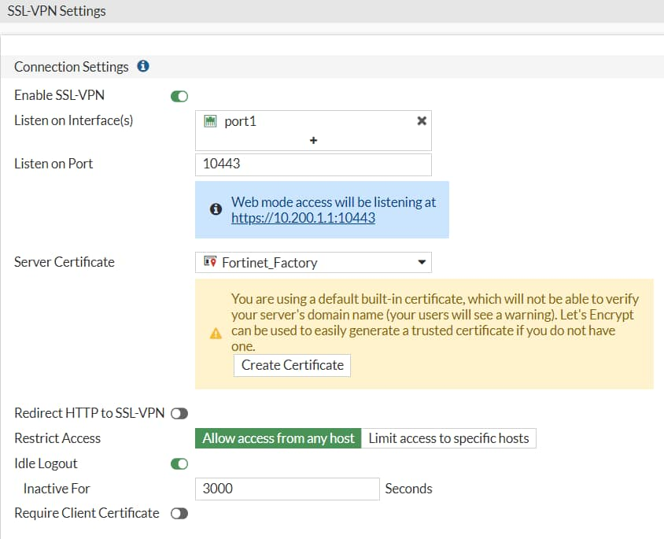
Configure SSL VPN Settings
VPN > SSL VPN Settings
FortiGate interface for SSL VPN portal:
  Default port is 443
  By default, the admin GUI interface and the SSL VPN portal use same HTTPS port
    Advised to use different interfaces for admin GUI access and SSL VPN portal
    If both services use the same interface and port, only the SSL VPN portal appears
Restrict access to known hosts
SSL VPN time out:
  Default idle: 300 sec (5 min)
Digital server certificate:
  Self-signed certificate used by default
  To avoid browser security warnings, use a certificate issued by a public CA, generate a trusted certificate or install the self-signed certificate on all clients
Notes:
After you configure the SSL VPN portal, the next step is to configure the SSL VPN settings.
Let’s start with the Connection Settings section. Here, you need to map a FortiGate interface to the SSL VPN portal. The default port for the SSL VPN portal is 443. This means users need to connect to the IP address of the FortiGate interface mapped to the SSL VPN portal, using port443 HTTPS. If you enable Redirect HTTP to SSL VPN, users who connect using HTTP (TCP port 80) will be redirected to HTTPS.
Port 443 is the standard default port for administration of the HTTPS protocol. This is convenient because users do not need to specify the port in their browsers. For example, https://www.example.com/ automatically uses port443 in any browser. This is considered a valid setup on FortiGate because you usually don’t access the SSL VPN login through every interface. Likewise, you generally don’t enable administrative access on every interface of your FortiGate. So, even though the ports may overlap, the interfaces that each one uses to access may not. However, if the SSL VPN login portal and HTTPS admin access both use the same port, and are both enabled on the same interface, only the SSL VPN login portal will appear. To have access to both portals on the same interface, you need to change the port number for one of the services. If you change the administrator access port, this will affect the port number for that service on all interfaces.
Also, an inactive SSL VPN is disconnected after 300 seconds (5 minutes) of inactivity. You can change this timeout using the Idle Logout setting on the GUI.
Finally, like other HTTPS websites, the SSL VPN portal presents a digital certificate when users connect. By default, the portal uses a self-signed certificate, which triggers the browser to show a certificate warning. To avoid the warning, you should use a digital certificate signed by a publicly known certificate authority (CA). You can also generate a certificate for interface. Alternatively, you can load the FortiGate self-signed digital certificate into the browser as a trusted authority.

Slide 18
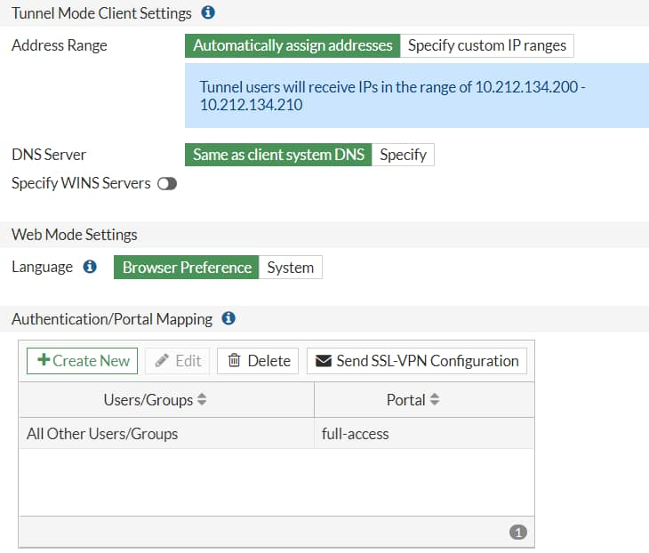
Configure SSL VPN Settings (Contd)
Define the IP range for the SSL VPN
  IPs are assigned to clients’ virtual adapters while joined to VPN
  IP allocation has two methods:
    First-available (default) or Round robin
    CLI only
    conf vpn ssl settings
    set tunnel-addr-assigned-method first-available/round-robin
    end
Resolve names by DNS server
  Use internal DNS if resolving internal domain names
  Optionally, resolve names by WINS servers
Specify authentication portal mapping
  Specify portals for each user or group
  Define portal for all other users or groups
    It cannot be deleted
VPN > SSL VPN Settings
Notes:
Define the tunnel-mode client settings and the authentication rules that map users to the appropriate portal.
When users connect, the tunnel is assigned an IP address. You can choose to use the default range or create your own range. The IP range determines how many users can connect simultaneously. There are two IP allocation methods and only available in CLI as shown in the slide:
First-available (default setting)
Round robin
Please note when round-robin is used, address pools defined in web portal is ignored, and the tunnel-ip-pools or tunnel-ipv6-pools under ssl vpn setting must be set. Only one set of IP pool address is allowed.
DNS server resolution is effective only when the DNS traffic is sent over the VPN tunnel. Generally, this will be the case only when split tunnel mode is disabled and all traffic is being sent from the user’s computer across the tunnel.
Finally, you can allow different groups of users to access different portals. In the example shown on this slide, teachers have access only to the web portal. Accountants can use FortiClient to connect in tunnel mode.

Slide 19
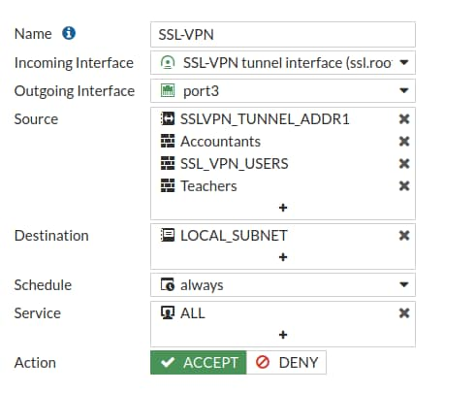
Firewall Policies to and from SSL VPN Interface
Listens for connections to the SSL VPN portal
ssl.<vdom_name> policy enables portal with user authentication
The selected Incoming Interface is the SSL VPN virtual interface
  Example: ssl.root for root VDOM
Passes decrypted traffic to the selected Outgoing Interface
Policy & Objects > Firewall Policy
Add the user/groups for SSL VPN authentication.
Otherwise, users will be denied permission
Notes:
The fourth, and last, mandatory step involves creating firewall policies for logging on.
SSL VPN traffic on FortiGate uses a virtual interface called ssl.<vdom_name>. Each virtual domain (VDOM) contains a different virtual interface based on its name. By default, if VDOMs are not enabled, then the device operates with a single VDOM called root.
To activate and successfully log in to the SSL VPN, there must be a firewall policy from the SSL VPN interface to the interface to which you want to allow access for the SSL VPN users, including all of the users and groups that can log in as the source. Without a policy like this, no login portal is presented to users.
If there are resources behind other interfaces that users need access to, then you need to create additional policies that allow traffic from ssl.root to exit those interfaces.

Slide 20



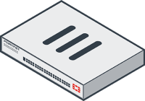

Example: Access to Resources
All traffic generated by the user exits through the ssl.<vdom_name> interface
  Applies to both web and tunnel mode
Access to Internet
edit 10
set srcintf ssl.root
set dstintf port1
set srcaddr all
set dstaddr all
Access to Database
edit 11
set srcintf ssl.root
set dstintf internal
set srcaddr all
set dstaddr Database
Database
10
12
internal
SSL VPN
Access to Mail_Server
edit 12
set srcintf ssl.root
set dstintf dmz
set srcaddr all
set dstaddr Mail_Server
Users:
- Accountants
- Teachers
Wan1
(Port1)
dmz
11
Mail_Server
Notes:
Any traffic from SSL VPN users, whether in web portal or tunnel mode, exits from the ssl.<vdom_name> interface.
This slide shows an example of firewall policies that are configured to allow access to resources behind other interfaces that users need access to when connected through SSL VPN.
Optionally, if split tunneling is disabled, you need to create an additional firewall policy from ssl.root to the egress interface to allow clients access to the internet.
You can also apply security profiles to this firewall policy to restrict user access to the internet.

Slide 21
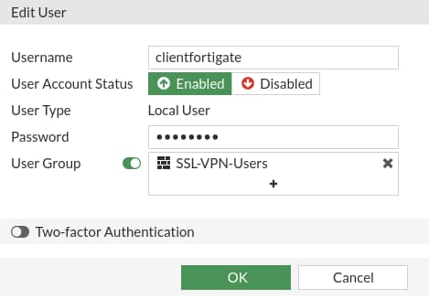
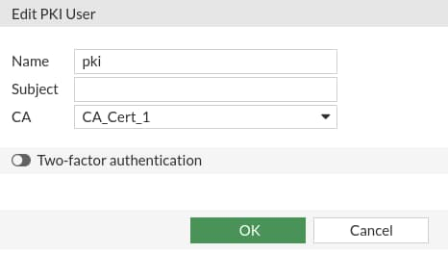
Configuring SSL VPN—FortiGate as Server
SSL VPN Server FortiGate
  Set up user accounts and groups for remote SSL VPN users
    Create two accounts: local/remote and PKI
    Require clients to authenticate using their certificates as well as username and password
  Configure SSL VPN portals
  Configure SSL VPN settings
    Authentication rules include both accounts using CLI
  Create a firewall policy to and from the SSL VPN interface
  Create a firewall policy to allow SSL VPN traffic to the internet (optional)
Use CLI to create first PKI user to get PKI menu on GUI
User & Authentication > User Definition
User & Authentication > PKI
config user peer
edit pki
set ca “CA_Cert_1
set cn “FGVM01TM905”
end
Notes:
To configure SSL VPN, you must take these steps:
SSL VPN server FortiGate:
Set up user accounts and groups for remote SSL VPN users.
Create two accounts: local/remote and PKI. The PKI menu is only available in the GUI after a PKI user has been created using the CLI, and a CN can only be configured in the CLI. If no CN is specified, then any certificate that is signed by the CA will be valid and matched.
Require clients to authenticate using their certificates as well as username and password.
Configure SSL VPN portals.
Configure SSL VPN settings.
Authentication rules include both accounts using CLI.
Create a firewall policy to and from the SSL VPN interface.
Create a firewall policy to allow SSL VPN traffic to the internet (optional).

Slide 22
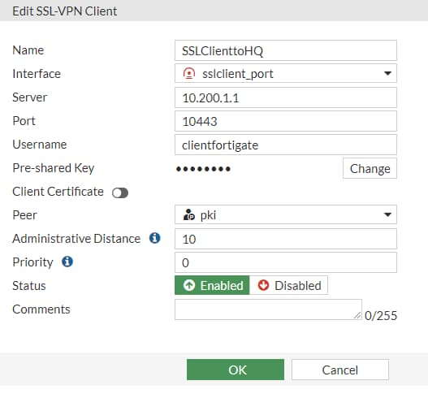
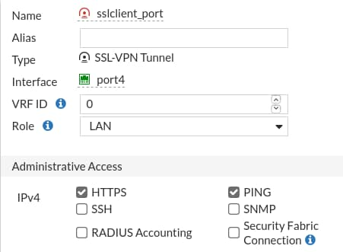
Configuring SSL VPN—FortiGate as Client
SSL VPN Client FortiGate
  Create PKI user
    Select CA certificate that allows the FortiGate to complete the certificate chain and verify the server 's certificate
  Create SSL VPN tunnel interface using ssl.<vdom> interface
  Create and configure the SSL VPN Client settings on VPN > SSL-VPN Clients
  Create a firewall policy from internal interface to the SSL VPN interface
VPN > SSL-VPN Clients > Create New
Network > Interface > Create New
Client Name
Interface Name
Virtual SSL interface
Type: ssl.<vdom_name>
Server FortiGate IP Address and SSL Port
Select port to reach server FortiGate
Local and PKI user details including local cert to identify this client
Dynamic route priority and distance settings
Notes:
To configure SSL VPN, you must take these steps:
SSL VPN Client FortiGate:
Create PKI user:
Set the same CN using CLI if PKI user on server FortiGate has CN configured.
Select CA certificate that allows the FortiGate to complete the certificate chain and verify the server 's certificate.
Create SSL VPN tunnel interface using ssl.<vdom> interface.
Create and configure the SSL VPN client settings on VPN > SSL-VPN Clients, it includes:
Client name
Virtual SSL VPN interface
SSL VPN server FortiGate IP address and SSL port number
Local username and password and PKI(Peer) user. The Client Certificate is the local certificate that is used to identify this client, and is assumed to already be installed on the FortiGate. The SSL VPN server requires it for authentication.
When split tunnel is disabled, new default route is added and priority and distance plays an important role.
Create a firewall policy to allow traffic from internal interface to the SSL VPN interface.

Slide 23

Client Integrity Checking
SSL-VPN gateway checks client integrity
  Requires Microsoft Windows
  Supported in SSL VPN tunnel mode only
Detects client security applications recognized by the Windows Security Center
  Antivirus and firewall software
  Security attributes recorded on the client’s computer
Checks the status of applications through their globally unique identifier (GUID)
  Custom host checks
Determines the state of the applications
  Active/inactive
  Current version number
  Signature updates
Notes:
When a user connects to your network through an SSL-VPN, a portal is established between your network and the user’s PC. The VPN session is secured natively in two ways: the connection is encrypted and the user must log in with their credentials, such as a username and password. However, you can configure additional checks to increase the security of the connection.
One method of increasing your security is by using client integrity checking. Client integrity ensures that the connecting computer is secure by checking whether specific security software, such as antivirus or firewall software, is installed and running. This feature supports only Microsoft Windows clients, because it accesses the Windows Security Center to perform its checks. Alternatively, you can customize this feature to check the status of other applications using their GUIDs. A GUID is a unique ID in the Windows Configuration Registry that identifies each Windows application. Client integrity can also check the current software and signature versions for the antivirus and firewall applications.
Client integrity checking is applicable to tunnel mode only.

Slide 24
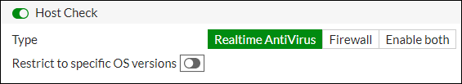
Configure the Client Integrity Check
Uses external vendor software to ensure client integrity:
  FortiClient, AVG, CA, F-Secure, Kapersky, McAfee, Norton, Symantec, Panda, Sophos, Trend-Micro, Zone Alarm,…
Checks whether the software is installed on host client:
  Configure through CLI or GUI
  Software must be updated and recognized by Windows Security Center
    None – No host checking
    av – Verify if there is any antivirus software
    fw – Verify if there is any firewall software
    av-fw – Verify if there is both antivirus and firewall software
    Custom – Verify custom or proprietary software
  If the software is not installed, FortiGate rejects SSL-VPN connection attempt
config vpn ssl web host-check-software
show
VPN > SSL-VPN Portals > portal-name
config vpn ssl web portal
edit <portal_name>
set host-check [none|av|fw|av-fw|custom]
set host-check-interval <seconds>
end
Administrators should have in-depth knowledge of the Windows OS to use and maintain this feature
Notes:
FortiGate performs the client integrity check while the VPN is still establishing, just after user authentication has finished. If the required software is not running on the user’s PC, FortiGate rejects the VPN connection attempt, even with valid user credentials. You enable client integrity for each web portal, and you configure it using CLI commands or the FortiGate GUI.
The list of recognized software, along with the associated registry key value, is available on the CLI only. Software is split into three categories: antivirus (av), firewall (fw), and custom. Custom is used for customized or proprietary software that an organization may require. Administrators can configure av, fw, or both settings on the GUI or CLI, but the custom setting is available only on the CLI.
Administrators can also configure OS versions and patch settings to allow or deny VPN connections from specific OS versions.
The disadvantage of enabling client integrity checking is that it can result in a lot of administrative overhead because of the following factors:
All users must have their security software up to date in order to successfully establish a connection.
Software updates can result in a change to the registry key values, which can also prevent a user from successfully connecting.
As such, administrators must have in-depth knowledge of the Windows operating system and subsequent registry behavior in order to properly make extended use of and maintain this feature.

Slide 25
Which step is necessary to configure SSL VPN connections?
  Create a firewall policy from the SSL VPN interface to the resource’s interface.
  Enable event logs for SSL VPN traffic: users, VPN, and endpoints.
Which action may allow internet access in tunnel mode, if the remote network does not allow internet access to SSL VPN users?
  Enable split tunneling
  Configure the DNS server to use the same DNS server as the client system DNS

Slide 26
SSL VPN Deployment Modes
Configuring SSL VPNs
Monitoring and Troubleshooting
Notes:
Good job! You now understand how to configure FortiGate for SSL VPN connections.
Now, you’ll learn how to monitor SSL VPN sessions, review logs, configure SSL VPN timers, and troubleshoot common issues.

Slide 27
Monitoring and Troubleshooting
Monitor SSL VPN-connected users
Review SSL VPN logs
Configure SSL VPN timers
Troubleshoot common SSL VPN issues
Identify hardware acceleration components for SSL VPN
Notes:
After completing this section, you should be able to achieve the objectives shown on this slide.
By demonstrating competence in SSL VPN monitoring and troubleshooting, you will be able to avoid, identify, and solve common issues and misconfigurations.

Slide 28
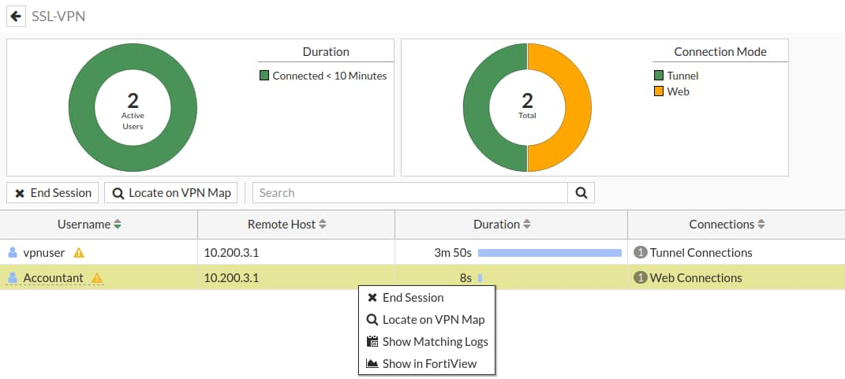
Monitoring SSL VPN Sessions
Monitor which SSL VPN users are connected
  GUI: Dashboard > Network > SSL VPN
Shows SSL VPN user names, connection times, and IP addresses
  For tunnel mode, Active Connections displays IP address assigned to fortissl virtual adapter
Force end user disconnection
  Right-click the user name and select End Session
Dashboard > Network > SSL VPN
Tunnel mode user: shows SSL VPN IP address assigned during the session
Select or Right-click to terminate an active SSL VPN session
web user
Notes:
You can monitor which SSL VPN users are connected on the SSL VPN widget. This shows the names of all SSL VPN users that are currently connected to FortiGate, their IP addresses (both inside the tunnel and outside), and connection times.
When a user connects using tunnel model, the Active Connections column shows the IP address assigned by FortiGate to the fortissl virtual adapter on the client’s computer. Otherwise, the user is connected only to the web portal page.

Slide 29
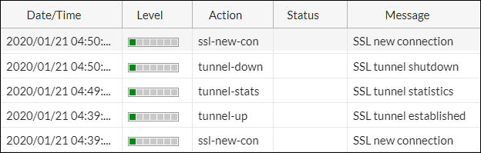
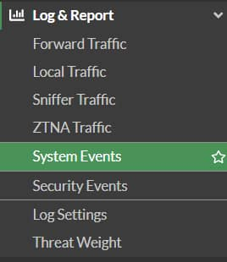
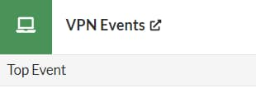

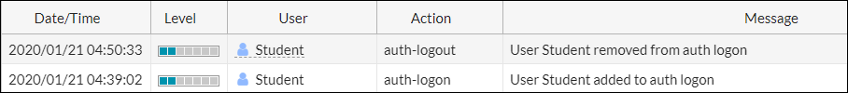
SSL VPN Logs
Custom URL path
Custom URL path
Review if the SSL VPN tunnel is established or closed
Review the authentication action related to SSL VPN users
Review SSL VPN connections in tunnel mode with FortiClient
Notes:
You can also review SSL VPN logs. On Log & Report > System Events:
Select VPN Events widget to show new connection requests, and if the SSL VPN tunnel is established or closed.
Select User Events widget to see the authentication action related to SSL VPN users.

Slide 30
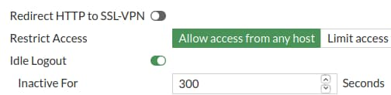
SSL VPN Idle Timeout vs. Authentication Session
Firewall policy authentication session is associated with SSL VPN tunnel session
  Firewall policy authentication session is forced to end when SSL VPN tunnel session ends
  Prevents reuse of authenticated SSL VPN firewall sessions (not yet expired) by a different user, after the initial user terminates the SSL VPN tunnel session
SSL VPN authentication is not subject to the firewall authentication timeout setting
  It has a separate idle setting: default 300 seconds
VPN > SSL VPN Settings
config vpn ssl settings
set idle-timeout <0-259200>
end
Notes:
When an SSL VPN is disconnected, either by the user or through the SSL VPN idle setting, all associated sessions in the FortiGate session table are deleted. This prevents the reuse of authenticated SSL VPN sessions (not yet expired) after the initial user terminates the tunnel.
The SSL VPN user idle setting is not associated with the firewall authentication timeout setting. It is a separate idle option specifically for SSL VPN users. A remote user is considered idle when FortiGate does not see any packets or activity from the user within the configured timeout period.

Slide 31
SSL VPN Timers
Set up timers to avoid logouts when SSL VPN users are connected over high latency connections
  DTLS hello timeout—default 10 seconds
  Login timeout—default 30 seconds
Timers can also help to mitigate DoS attacks within SSL VPN caused by partial HTTP requests, such as Slowloris and R-U-Dead-Yet
config vpn ssl settings
set login-timeout <10-180>
set dtls-hello-timeout <10-60>
set http-request-header-timeout <1-60>
Set http-request-body-timeout <1-60>
end
Notes:
When connected to SSL VPN over high latency connections, FortiGate can time out the client before the client can finish the negotiation process, such as DNS lookup and time to enter a token. Two new CLI commands under config vpn ssl settings have been added to address this. The first command allows you to set up the login timeout, replacing the previous hard timeout value. The second command allows you to set up the maximum DTLS hello timeout for SSL VPN connections.
Also, timers can help you to mitigate vulnerabilities such as Slowloris and R-U-Dead-Yet, that allow remote attackers to cause a denial of service through partial HTTP requests.

Slide 32
Best Practices for Common SSL VPN Issues
For web mode connections, make sure that:
  Cookies are enabled and the internet privacy options are set to high in your web browser
  SSL VPN clients are following the proper URL structure: https://<FortiGateIP>:<port>
For tunnel mode connections, make sure that:
  The FortiClient version is compatible with the FortiOS firmware
    Refer to release notes for product compatibility and integration
  Split tunneling is enabled to allow internet access without backhauling all user’s data to the remote network, or
  Split tunneling is disabled and an egress firewall policy is created for SSL VPN connections
For general SSL VPN connections, make sure that:
  Users are connecting to the correct port number
    To check SSL VPN port assignment, click VPN > SSL VPN Settings
  Firewall policies include SSL VPN groups or users, and the destination address
  The timeout timer is configured to flush inactive sessions after a short time
  Users are encouraged to log out if they are not using the network resources only accessible by SSL VPN
Notes:
The following are some best practices to keep in mind when using SSL VPNs. These best practices can also be helpful in many SSL VPN troubleshooting situations:
Enable cookies in your web browser
Set internet privacy options to high in your web browser
Use a FortiClient version that is compatible with your FortiOS firmware
Enable split tunneling or create an egress firewall policy for SSL VPN connections in order to allow access for external resources
Connect to the correct port number
Add SSL VPN groups, SSL VPN users, and destination addresses to the firewall policies
Flush inactive sessions by timeout

Slide 33
Useful Troubleshooting Commands
# diagnose debug enable # diagnose vpn ssl <…>
list | Show current connections
info | General SSL VPN information
statistics | Show statistics about memory usage on FortiGate, maximum and current connections
debug-filter | Debug message filter for SSL VPN
hw-acceleration-status tunnel-test web-mode-test | Display the status of SSL hardware acceleration Enable/disable SSL VPN old tunnel mode IP allocation method Enable/disable random session ID in proxy URL for testing
# diagnose debug application sslvpn -1 |  | Display debug messages for SSL VPN; -1 debug level produces detailed results
# diagnose debug enable Check debug logs on the FortiClient
Notes:
There are several useful troubleshooting commands available under diagnose vpn ssl. They include:
list: Lists logged-on users
info: Shows general SSL VPN information
statistics: Shows statistics about memory usage on FortiGate
hw-acceleration-status: Displays the status of SSL hardware acceleration
tunnel-test: Enables or disables SSL VPN old tunnel mode IP allocation method
web-mode-test: Enables or disables random session ID in proxy URL for testing
The command diagnose debug application sslvpn shows the entire list of debug messages for SSL VPN connections.
Remember, to use the commands listed above, you must first run the diagnose debug enable command. Also, check SSL VPN debug logs on FortiClient.

Slide 34
Hardware Acceleration for SSL VPN
FortiGate devices with content processors (CP8 or CP9), which offload specific CPU-intensive operations, support high-performance SSL VPN bulk data engines
  SSL/TLS protocol processor
Administrators can disable CP offloading through firewall policies
  For example: test purposes
To view the status of SSL VPN acceleration, use the following command:
config firewall policy
edit 1
set auto-asic-offload [enable |disable]
end
get vpn status ssl hw-acceleration-status
Acceleration hardware detected: kxp=on cipher=on
No acceleration hardware detected
Notes:
FortiGate devices that have CP8 or CP9 content processors, which accelerate many common resource-intensive, security-related processes, can offload SSL VPN traffic to a high-performance VPN bulk data engine.
This specialized IPsec and SSL/TLS protocol processor processes most of the latest well-known algorithms for encryption.
By default, the offloading process is set up. If, for testing purposes you want to disable it, you can do it using the CLI only at the firewall policy configuration level.
You can also view the status of SSL VPN acceleration using the CLI.

Slide 35
What does the SSL VPN monitor feature allow you to do?
  Monitor SSL VPN user actions, such as authentication
  Force SSL VPN user disconnections
Which statement about SSL VPN timers is correct?
  SSL VPN timers can prevent logouts when SSL VPN users experience long network latency.
  The login timeout is a non-customizable hard value.

Slide 36
SSL VPN Deployment Modes
Configuring SSL VPNs
Monitoring and Troubleshooting
Notes:
Congratulations! You have completed this lesson.
Now, you will review the objectives that you covered in this lesson.

Slide 37
Describe the differences between SSL VPN modes
Define authentication for SSL VPN users
Configure SSL VPN portals
Configure SSL VPN settings
Define firewall policies for SSL VPN
Configure the client integrity check
Monitor SSL VPN connected users
Review SSL VPN logs
Configure SSL VPN timers
Troubleshoot common SSL VPN issues
Notes:
This slide shows the objectives that you covered in this lesson.
By mastering the objectives covered in this lesson, you learned how to configure and use SSL VPNs to give remote users access to your private network.

